Slide 1
AIML CA1
Jon Sham (P2317342)

Slide 2

Part A:
Predicting Water Quality

Slide 3

Introduction
Water quality is a critical factor that directly impacts human health and the environment. Monitoring and assessing water quality is essential for ensuring the safety of drinking water, preserving ecosystems, and preventing pollution. Traditional methods of water quality assessment involve extensive laboratory tests and manual measurements, which can be time-consuming and resource-intensive.

Slide 4
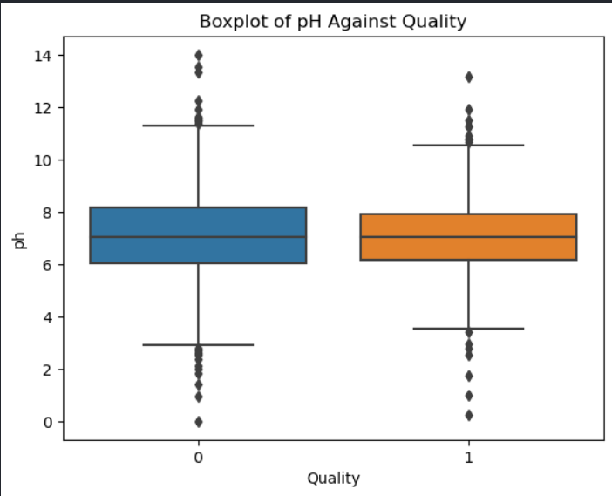
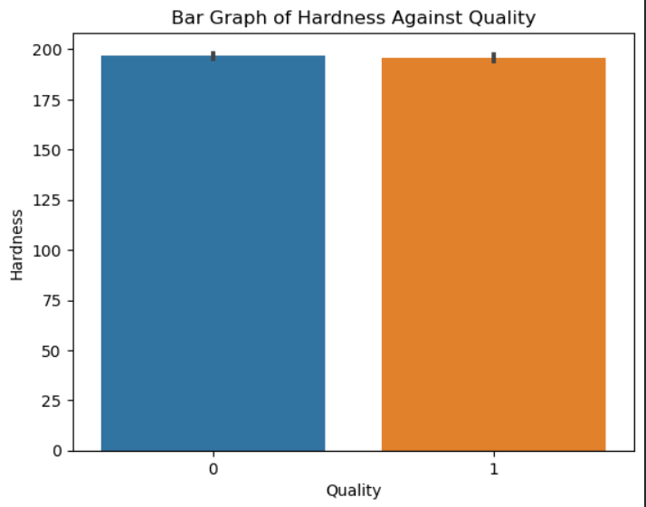
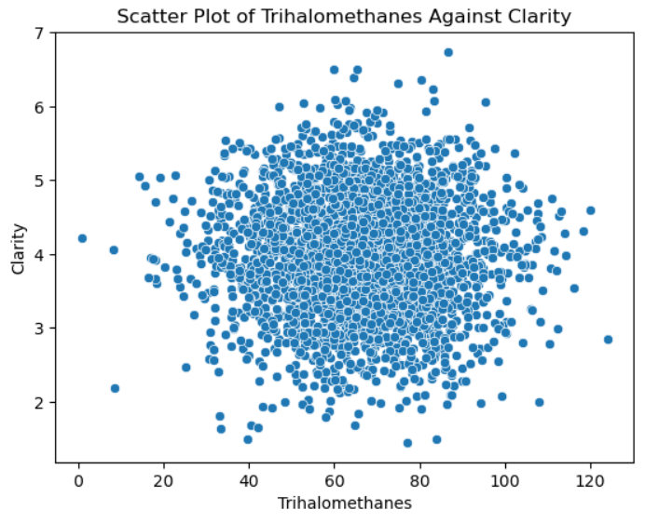
Data Exploration
For this section, I created different kinds of graphs to visualise the relationships between features and target. Here are some examples of the graphs:
A boxplot to show relationship between ph and Quality
As we can see, as quality increases, the ph range stabalizes closer to ph 7
A bar graph to show relationships between hardness and Quality
As we can see in the box plox above, there is minimal to no differences in hardness as quality increases
Ascatter plot to relationship between trihalomethanes and clarity
As we can see from the scatterplot there not much relationship between the two variables

Slide 5

Conclusion from Data Exploration
From the graphs, I got a great understanding of the features the target and their relationships. From this, I was able to get a feel of the features I felt were more important than the rest this would help me better do feature selection later on

Slide 6
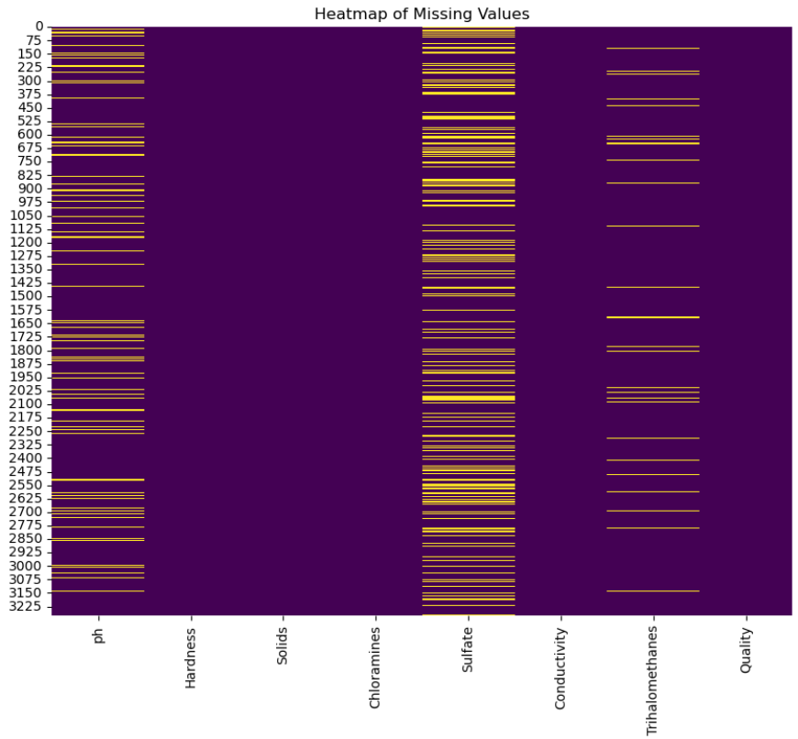
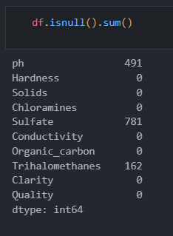
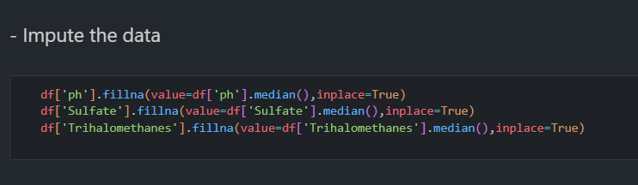
Feature Engineering
First thing I did in this section was deal with the missing values. First I plotted a heatmap of missing values indicated by the yellow markings
Then I ran a .isnull().sum() to find all NaN slots in the data
Then Imputed the data by filling empty data with the mean values of the column for ph, sulfate and trihalomethanes

Slide 7
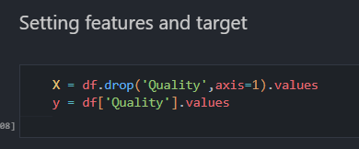
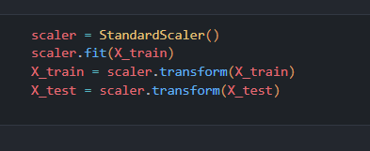
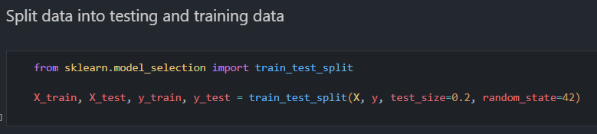
Next, I set the features and the target where the target was Quality
Then, I scaled the data to standardize the data
Afterward, I split the data into test and training data

Slide 8
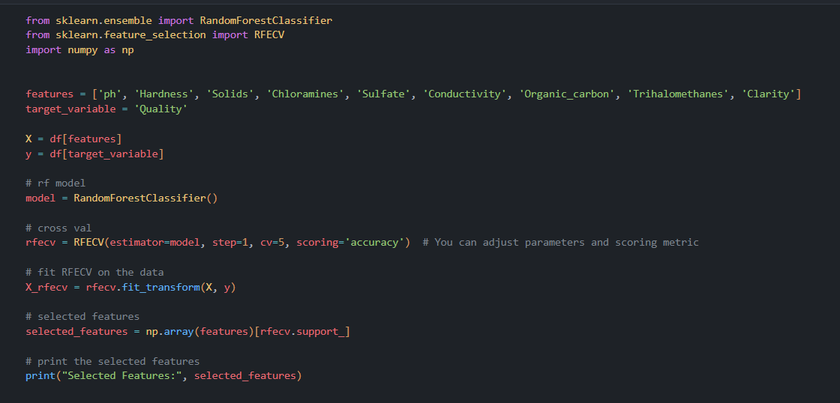
As for feature selection, I used Recursive Feature Addition to run through the data process involves training the model multiple times, each time adding one feature to the set of selected features. The feature that contributes the most to the model's performance is retained

Slide 9
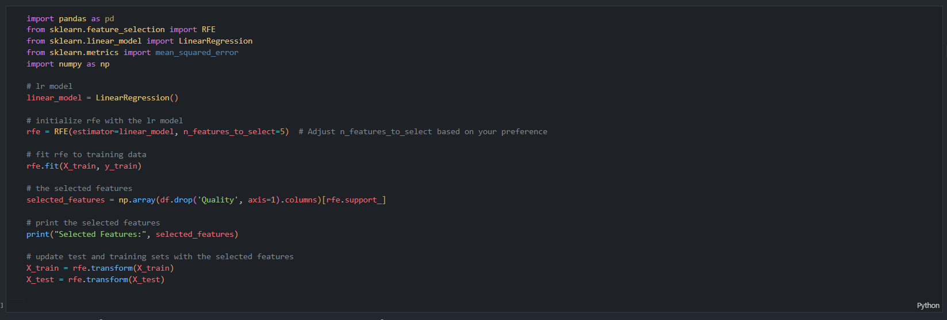
To further feature select I used Recursive Feature elimination which iteratively removes the least important features from a model, improving efficiency and focusing on the most relevant attributes for predictive tasks.

Slide 10
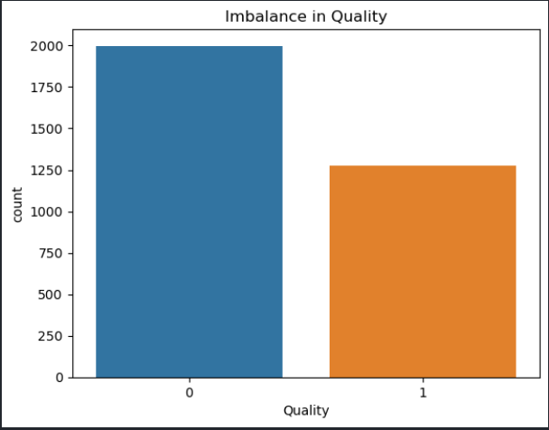
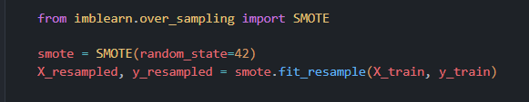
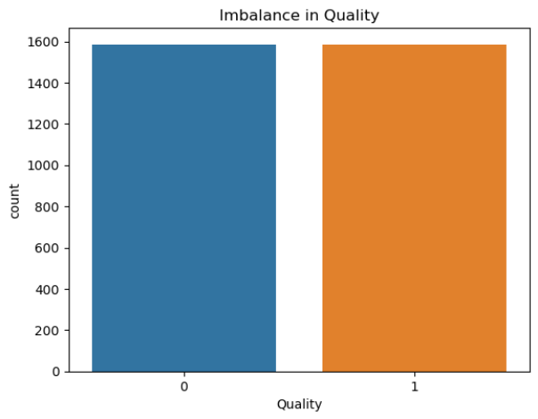
Next, I fixed the imbalanced by using Synthetic Minority Over-sampling Technique to create synthetic examples of the minority class.

Slide 11
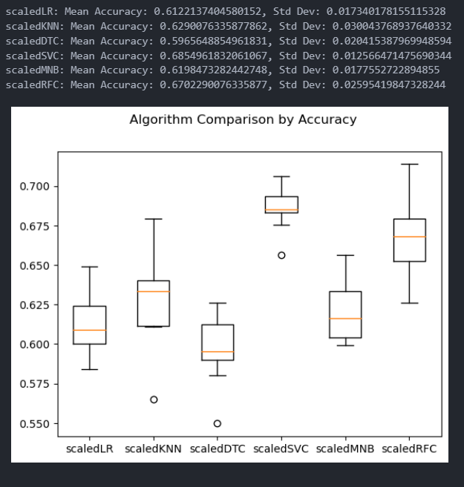
Modelling, Evaluation and Model Improvement
First I choose the top few models using a algorithm for comparison and plot a box plot to compare accuracies of the different models mainly lr, knn, dtc, svc, mnb and rfc

Slide 12
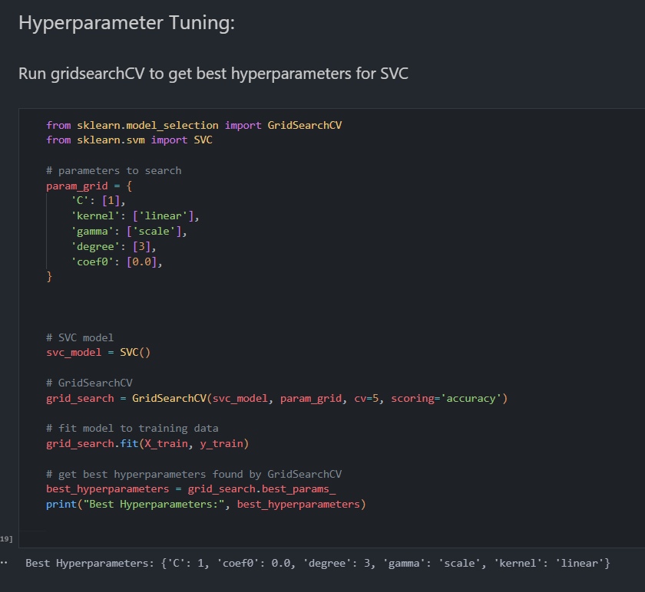
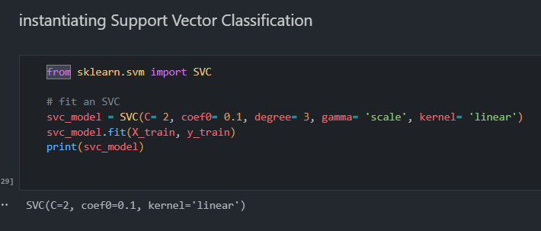
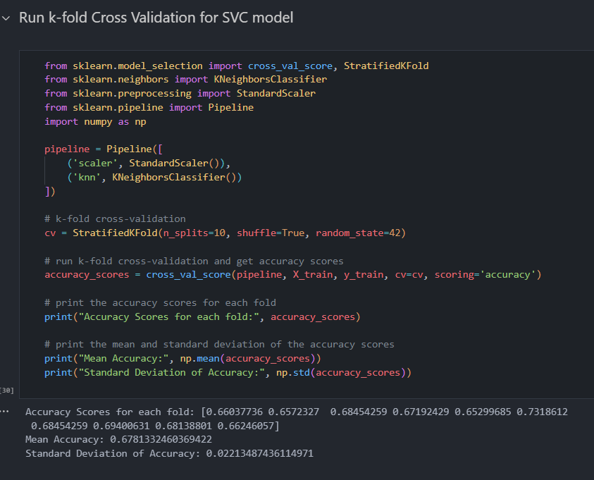
For the top 5 models I hyperparameter tuned using GridsearchCV
Instaintated each of the top 5 models, which was k nearest neighbors, support vector classification, gradient boosting, random forest and decision tree
Finally for each model run k-fold Cross Validation
In this case was support vector classification, I got C= 1, coef0= 0.0, degree= 3, gamma= 'scale', kernel= 'linear'
In this case I instantiated support vector classification
In this case for svc I obtained a mean accuracy of 0.678

Slide 13
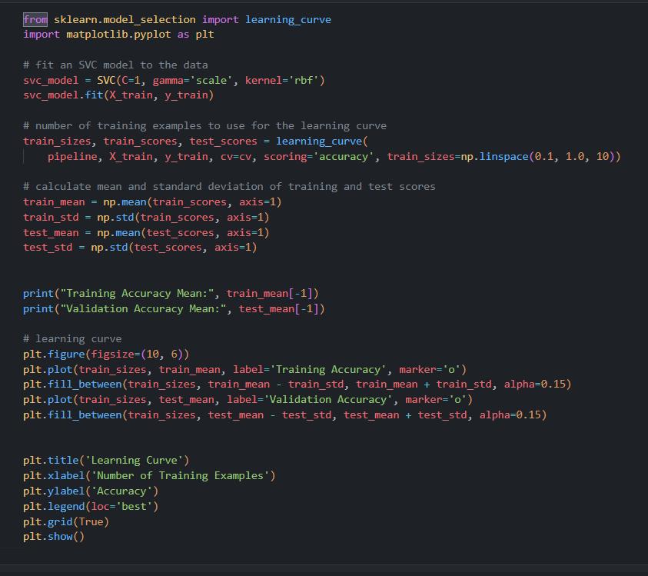
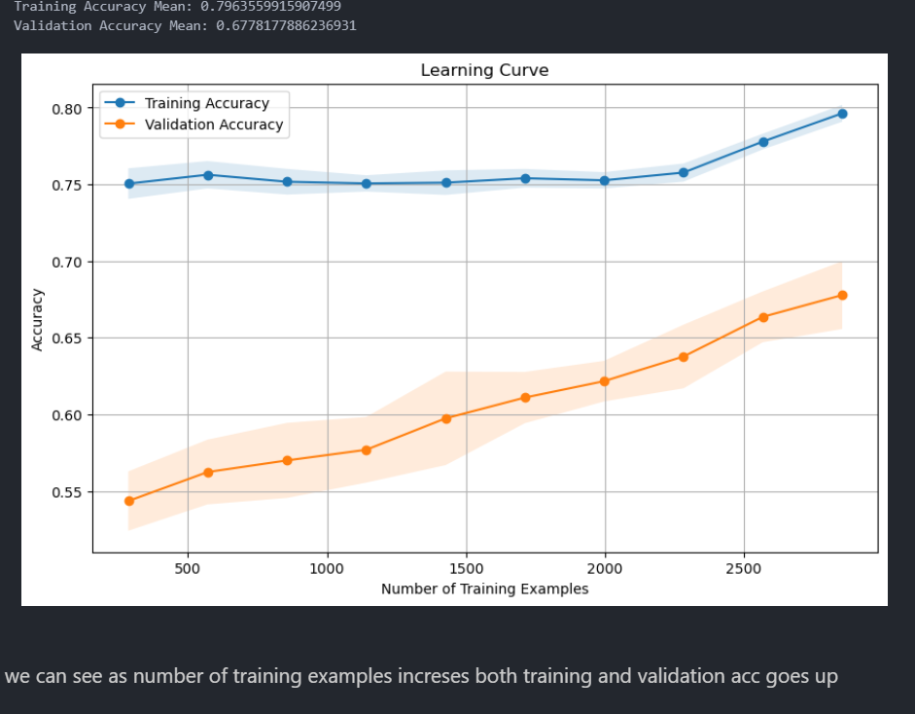
After that, I will plot the learning curve of each model to visualize and analyze the performance of a model as it learns from training data over multiple iterations, helping to assess model convergence, identify potential issues such as overfitting or underfitting, and determine the optimal amount of training data for achieving satisfactory performance

Slide 14
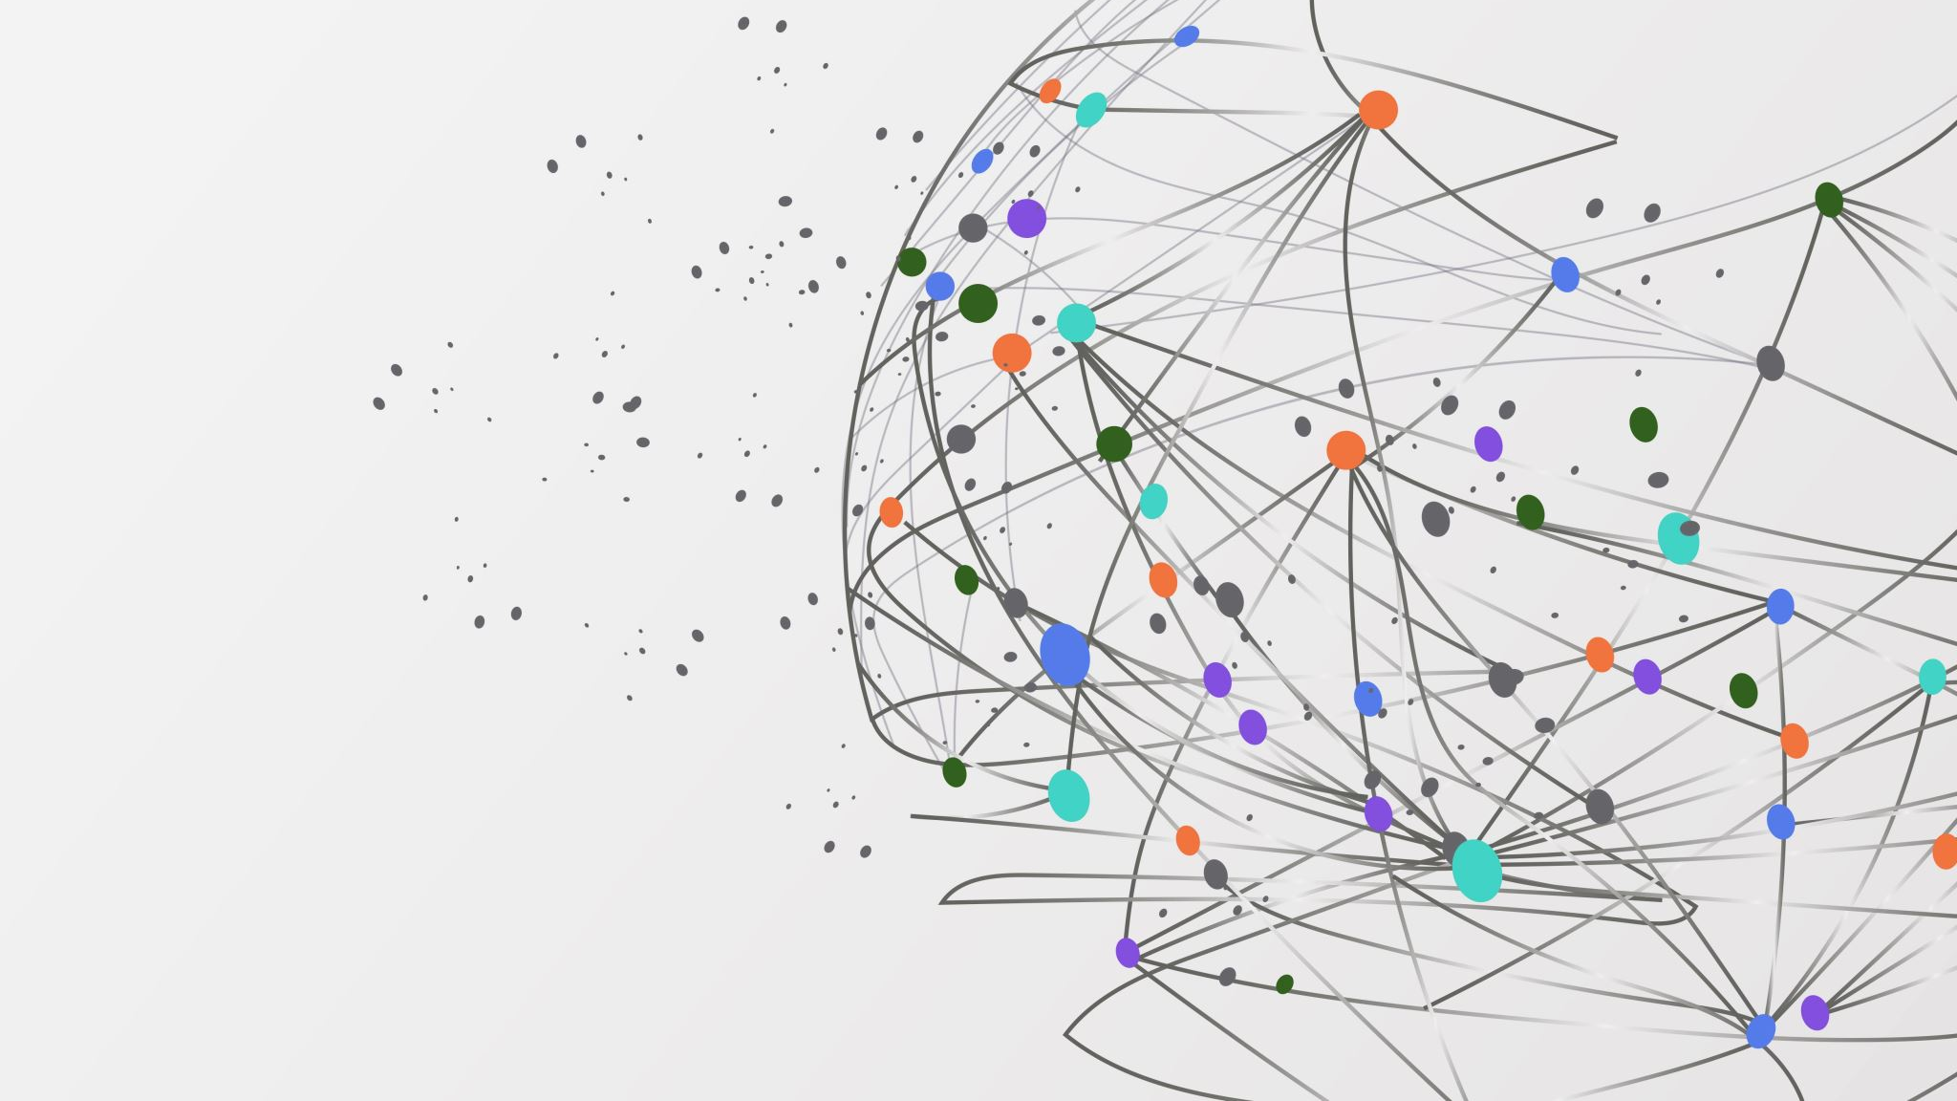
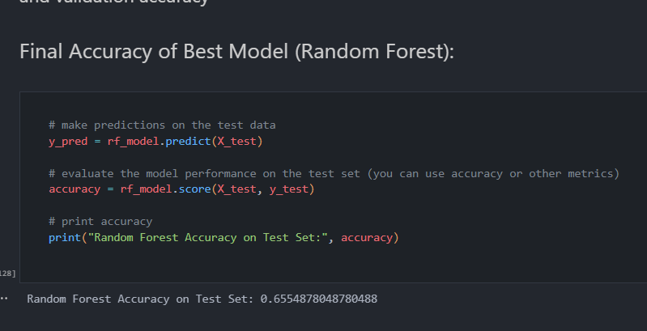
Now I test my best models final accuracy by testing it with the test data
In this case the final accuracy is 0.655 it seemed to have dropped as the validation acc was 0.736 thus may indicate my model was overfitted

Slide 15
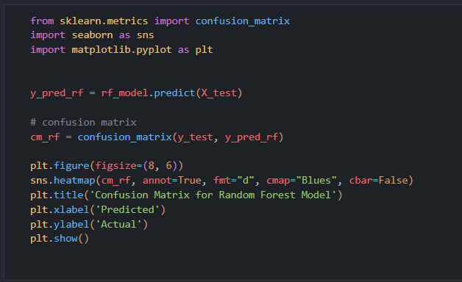
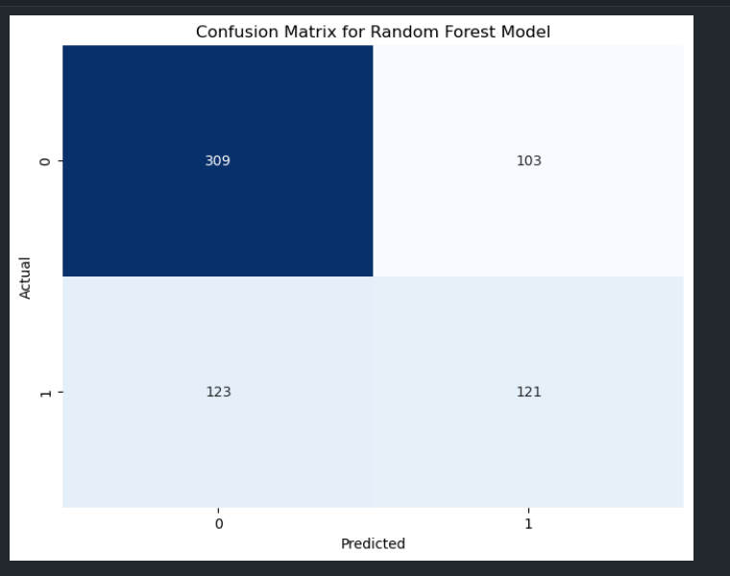
Next, I plot a confusion matrix of my best model to provide a summary of the model's predictions and the actual outcomes. I can gain insights into how well my model is performing, identify areas for improvement, and make informed decisions about adjusting the model or fine-tuning its parameters
In the case we see here, for my best model we can see my model got 309 true negatives and 121 true positives out of 983 predictions so that’s 430/983
i feel the model could have done better if given larger dataset but because i could not find any more useful relationship between features to add data i guess this would do

Slide 16
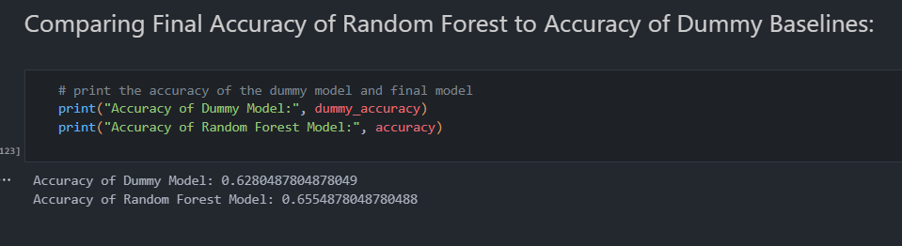
Next, I compared my best model to the stupid dummy baseline to see where my model stands in terms of accuracy.
In this case, my best model, represented by the Random Forest Model, outperformed the dummy baseline. The accuracy of the Random Forest Model is 0.655, demonstrating an improvement compared to the dummy model, which has an accuracy of 0.628. The higher accuracy of the Random Forest Model indicates its effectiveness against dummy in predicting water quality based on the provided features

Slide 17

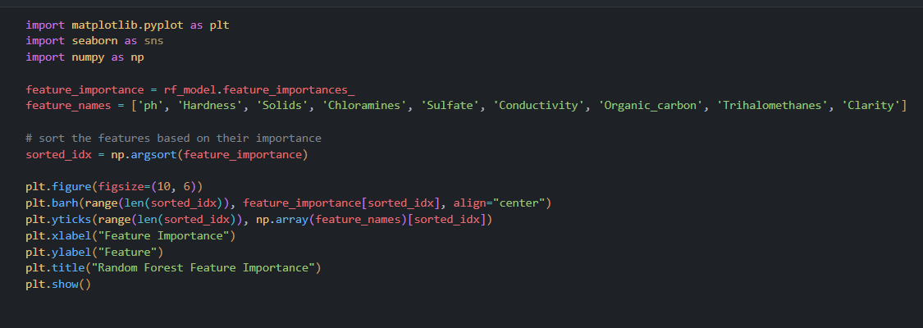
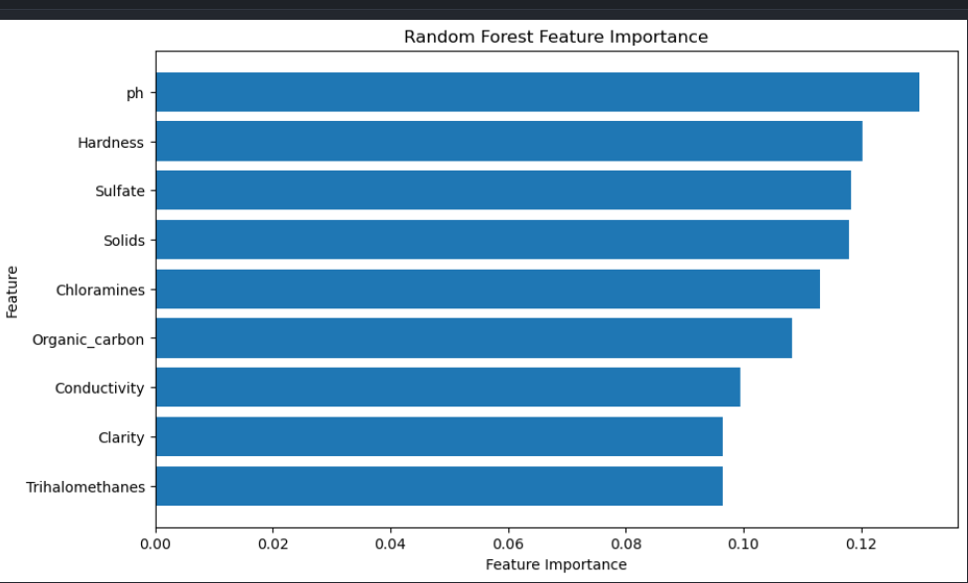
Next was ranking the models best features, for this I plotted a bar graph to show the top contributors of my models top features. As seen in the snap shot, ph is the top feature at feature importance 0.13 hence means considers this feature as important

Slide 18
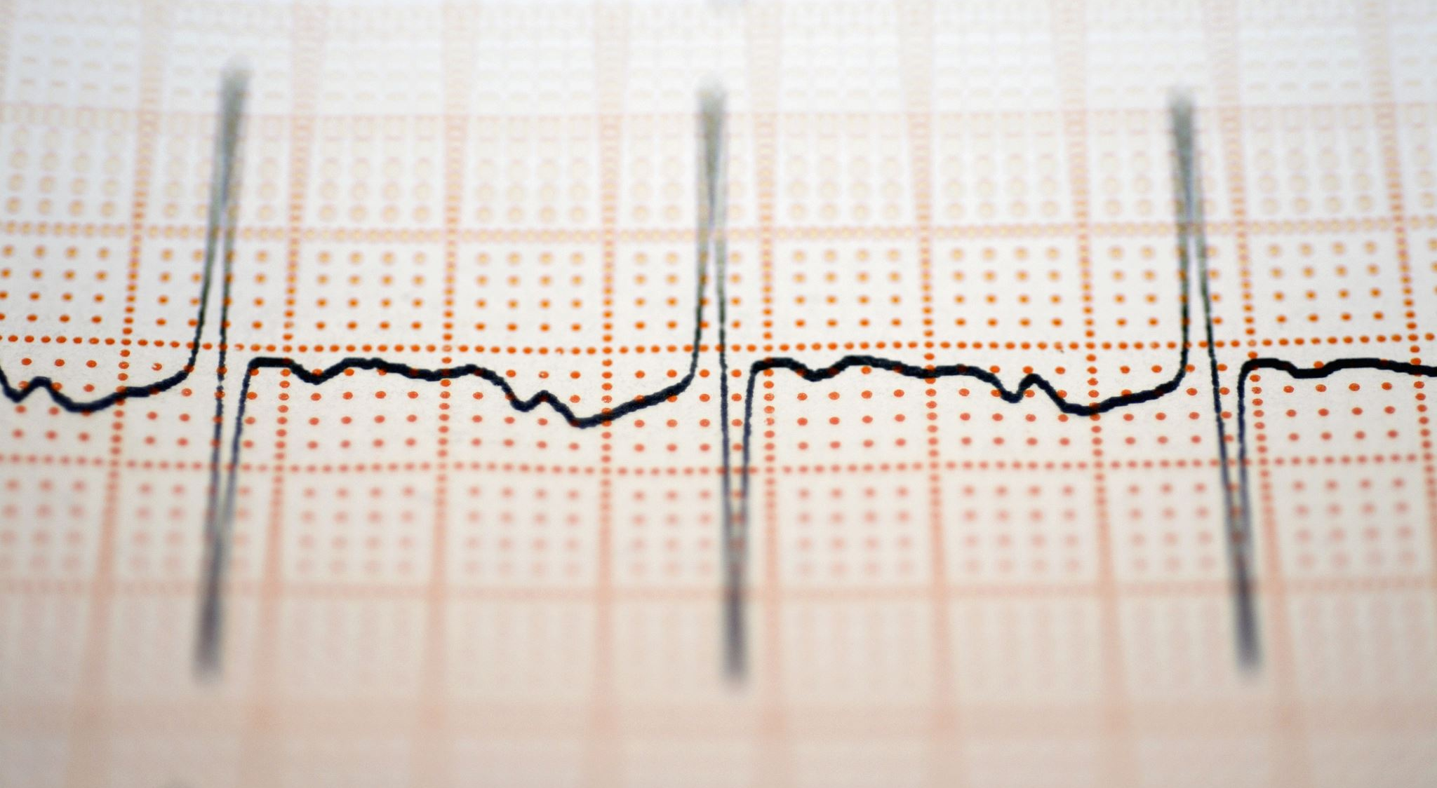
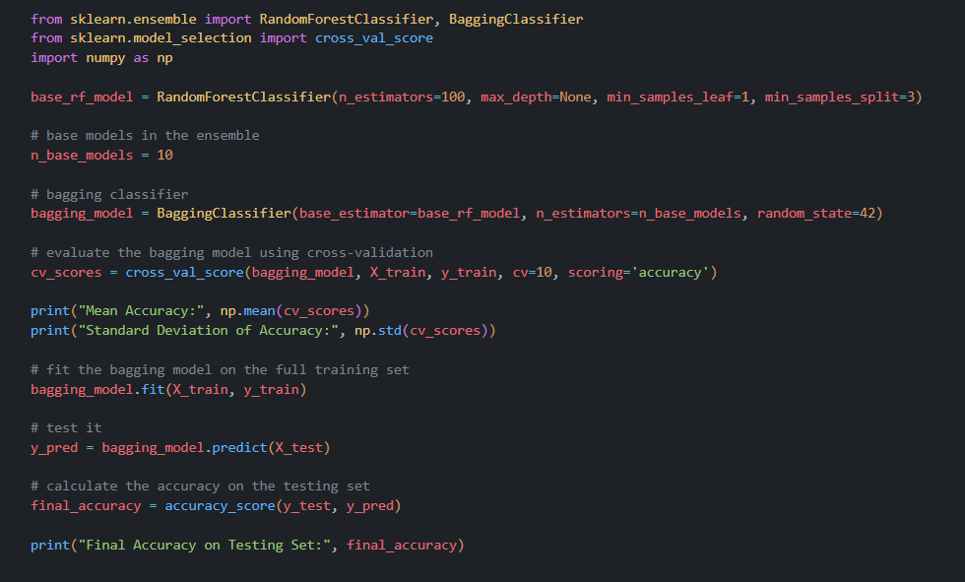

Model Improvisation
Since my model was overfitted, a suitable model improvisation was bagging because it works by training multiple instances of the same model on different subsets of the training data and then combining their predictions hence reducing overfitting. In this case you can see Bagging improved my models accuracy from 0.655 to 0.697 hence proved it did reduce overfitting

Slide 19
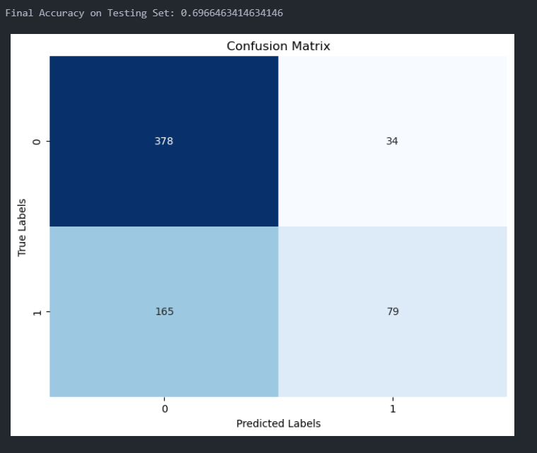
Finally plot another confusion matrix to see the improved models predictions.
As we can see, there was an improvement for the true negatives which went up from 309 to 378, thats 69 correct predictions more. However it should be noted that there was also a slight decrease for the true positives as i dipped from 121 to 79, which equates to 42 incorrect predictions. All in all i feel bagging did improve my model as if you take the correct prediction i gained minus the predictions i lost i still get an increase of 27 also mention that my final accuracy increased from 0.655 to 0.697.

